Slide 1
SCC211 Operation System
(Emerging Issues)
Zhang Jinyu – zjy@bjtu.edu.cn
School of Computer and Information Technology
SD408

Slide 2
MULTIPLE PROCESSORS

Slide 3
Asymmetric Multi-processing
Scheduler runs on single processor
Coordinates all others
Simple approach
Scheduler data structures only accessed by one (main) CPU
Remember in multi-processor systems
May be significant cost in moving processes
Invalidate some or all caches
I/O and interrupt handling may be bound to specific CPU
Some (specialist) processors may not be suited to task
Can’t move code from x86 to graphics processor (GPU), etc.

Slide 4
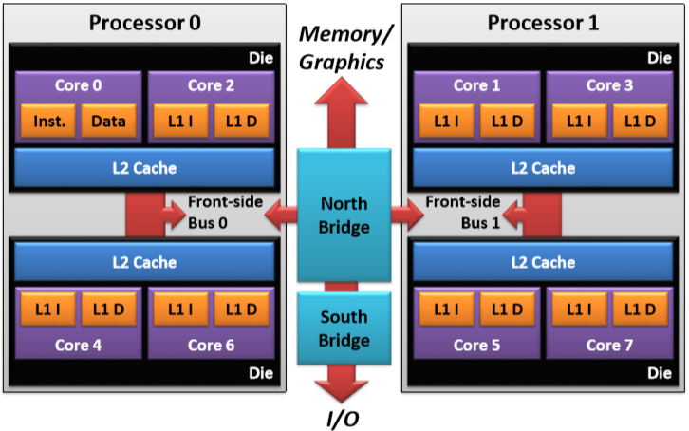
Processing Structure

Slide 5
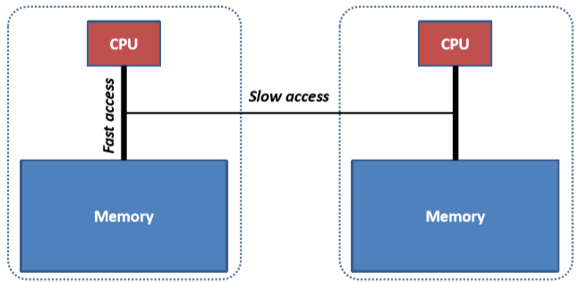
Non Uniform Memory Access (NUMA)
Memory to Processor access costs can differ
Especially on systems formed from CPU + memory cards

Slide 6
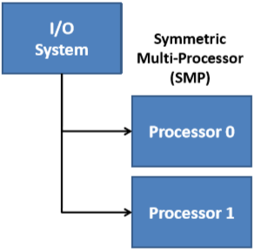
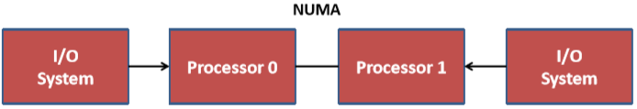
Interrupts and Multi-Processors
Interrupts need directing to appropriate processor
If handled on wrong CPU
Processor must forward requests
Or worse, need to move code and data
Extra overhead and latency
Particularly high cost in NUMA systems

Slide 7
Symmetric Multi-Processing (SMP)
Processors considered equal
Each processor runs own scheduler
Run queues either
Common/ shared between processors
Per-processor
Adds complexity of load-balancing/ process migration
Pull: Free processors may request additional processes
Push: Periodic task redistributes processes across CPU queues

Slide 8
Processor Affinity
Processes have
(Can run on) CPU affinity bitmask
Preferred and next CPU …see man task-set on Unix
We look for ready process to run on CPU n that:
Last ran on CPU n, or
Lists CPU n as a preferred CPU, or
Has a high priority (e.g. > 24 on NT)
…not so clear with virtual CPUs – hyper-threading
Virtual CPUs share and compete for same resources (caches , etc.)
Don’t move/ rearrange threads to free up CPUs

Slide 9
General Purpose GPU (GPGPU)
Graphics processors now common
Often underutilized
Growing interest in use for general processing
Number of OSs now use (conventional) GPU for user interface
Typically highly pipelined
Fine grained parallelism
Tend to have limited I/O interfaces → batch style processing
Excellent for dense vector and array operations
Currently need special libraries (e.g. CUDA)
Not generally schedulable within core OS

Slide 10
Multi-processor System
I/O Support
I/O PIC (or IO-APIC) routes interrupts to CPUs
CPUs each have own Local Advanced PIC (LAPIC)
Spin-Locks
Spin on shared (lock-release) object
Make little sense on single-processor systems
Useful for brief locks in multi-processor systems (still work going on)
Page replacement policies may differ, for example, NT uses
LRU in single-processor systems
FIFO in multi-processor systems

Slide 11
VIRTUALISATION

Slide 12
Virtualization: Motivation
Many machines under utilized, often idle
Normal application protection insufficient for
Server/ service protection
Cloud computing platforms
Not a new idea
Long offered by IBM OSs
Most recently in their z/VM system

Slide 13
Virtualization: Requirements
Each OS expects
Well known boot process
BIOS, GRUB/ NTLoader/ …, …
Processor(s)
Interrupt and timer systems
Reasonable amount of memory with known layout
Memory management system
Segmentation or Paging
Direct access to all IO subsystems
(PCI) device enumeration and inter-bus bridges
Range of IO devices
Protection system with distinct supervisor and user modes
Note: none of these are directly accessible from user mode

Slide 14
‘Unsupported’ Virtualization
Protecting components
Host OS runs in Supervisor/ System/ Kernel space
Guest OS runs in User space
Seen as ‘normal’ application level process
All apps. run in same User mode address space
Host OS based applications
Guest OS based applications

Slide 15
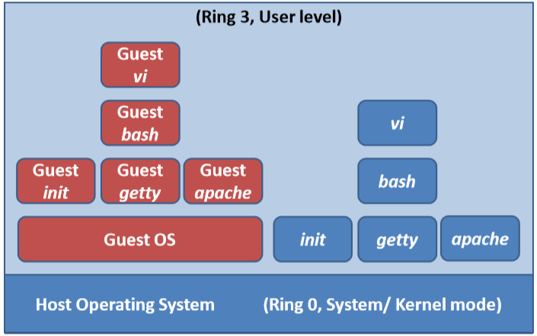
Running an OS as a User Application

Slide 16
‘Unsupported’ Virtualization on x86
x86 provides more than two protection levels
Could move Guest OS (Ring-0) functions to Ring-1
Host OS would still run in Ring-0
Applications continue to run in Ring-3
Note: such support is unusual so non-portable
• Most processors support only User/ Supervisor modes

Slide 17
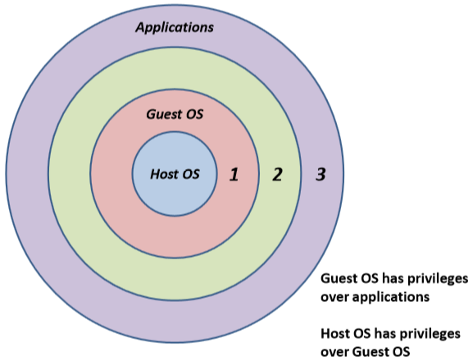
Adding Guest OS into Ring 1

Slide 18
‘Unsupported’ Virtualization
Some instructions work differently in rings-0 and 3
Don’t allow applications to configure Page Tables, etc.
Must trap these and use binary re-writing techniques
In general, we need a better solution…

Slide 19
Para-virtualization
Modify guest OS to be virtualization aware
CPU features accessed by function ‘calls’
Privileged instructions
Memory management, …
Up-calls in place of normal interrupt handling
Register interrupt handler functions to be up-called

Slide 20
Danger of Para-virtualization
Temptation to take things too far…
Kernel can
Become overly-dependent on one VM Monitor
At extreme, even limited to specific version of Monitor
Diverge into separate VM and Native kernels
Big problem if split becomes visible to applications

Slide 21
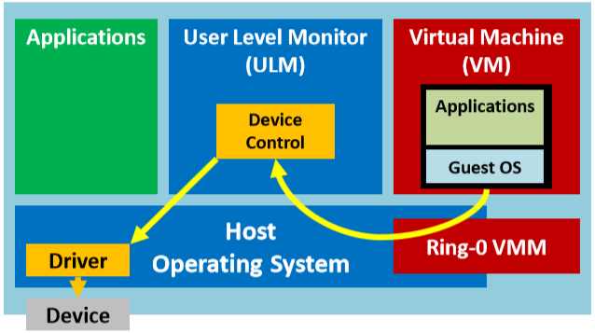
Virtualization Models: Hosted
Guest OSs sit ‘on top’ of existing OS and drivers

Slide 22
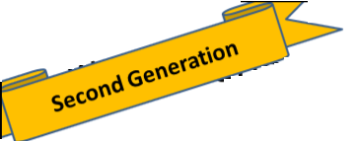
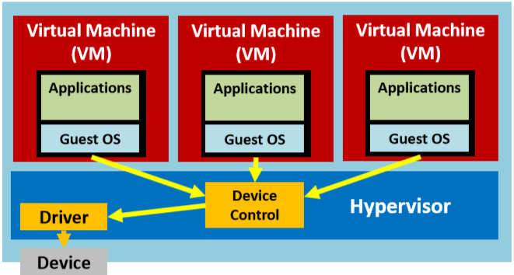
Virtualization Model: Hypervisor
Guests on top of minimal ‘kernel’/ hypervisor

Slide 23
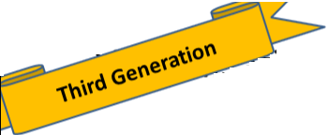
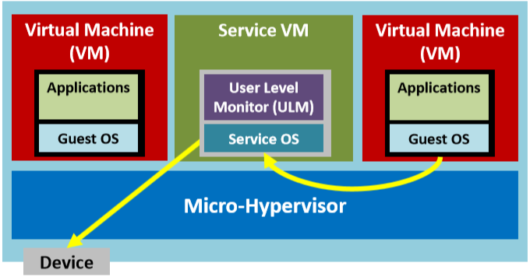
Virtualization Models: Hybrid
Hypervisor + ‘service OS’ with full driver set

Slide 24
Model Summary
First generation: OS-Hosted VM Monitor
Inefficient: fine granularity access to devices
Flexible: well established set of drivers
Second generation: Stand-alone Hypervisor VMM
Efficient, lightweight solution
Host OS restricted to more limited set of drivers, unless willing to pay penalty of first generation approach
Third generation: Hybrid VMM (Hypervisor + OSs)
Best of both worlds: lightweight solution with backup of protection and driver support of one or more support OSs

Slide 25
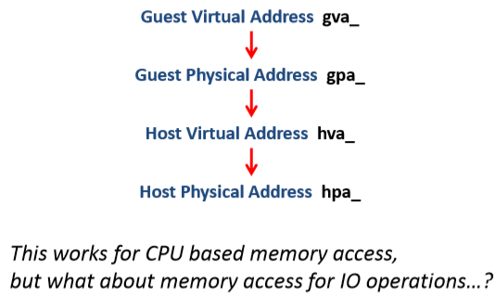
Accessing Memory
Now a fairly complex chain of address mappings
But can be pre-computed and loaded into host page tables

Slide 26
Return of Hardware Virtualization
Architectural support
Intel VT-x (IA32), VT-i (Itanium), and now Virtualization Technology for Directed IO (VT-d)
AMD-V and AMD Integrated Memory Controller
Peripheral Component Interconnect Express (PCIe) extensions
Single Root IO Virtualization (SR-IOV)

Slide 27
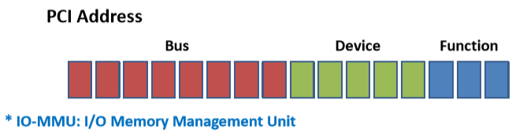
Intel VT-d IO-MMU
Offers VM level protected DMA via an IO-MMU *
If guest OS is IO-MMU aware, this may itself be virtualized
Adds Protection Domains based on PCI addresses
One domain per function
Each domain has own IO-MMU page tables

Slide 28
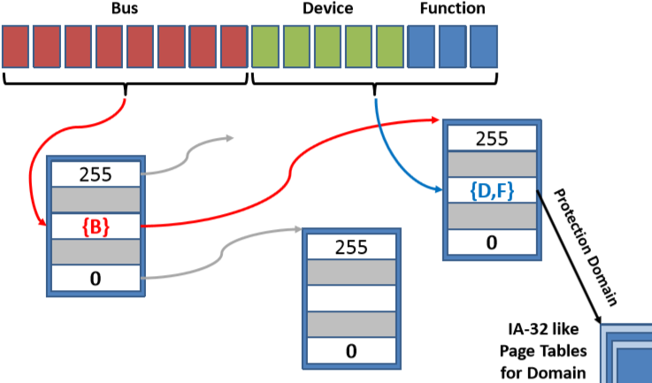
Intel VT-d Protect Domain Mapping

Slide 29
Single-Root IO Virtualization (SR-IOV)
Devices
Provide Physical Function (PF) and resource pool
Offer instances of PF known as Virtual Functions (VFs)
Allocated resources from PF pool
Have queue/ ring buffers for communication with VM
Given reference to IO-MMU descriptor for associated VM
VFs are invisible to normal device enumeration

Slide 30
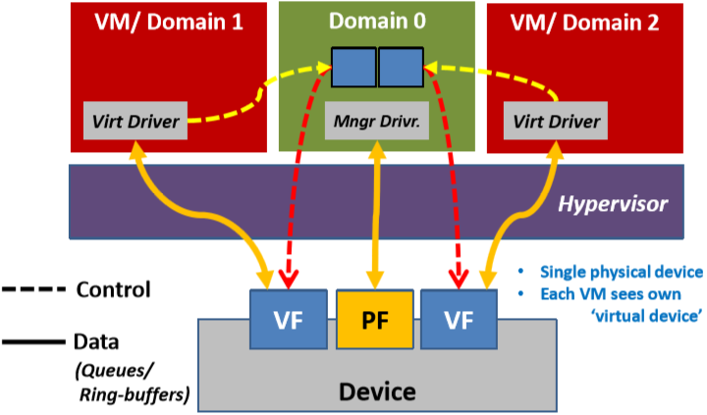
SR-IOV Devices

Slide 31
SPEEDING UP I/O
API Considerations…
用了缓存

Slide 32
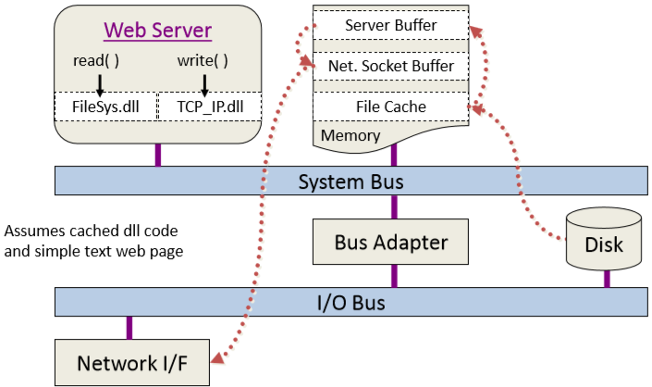
Life of a HTTP GET Request

Slide 33
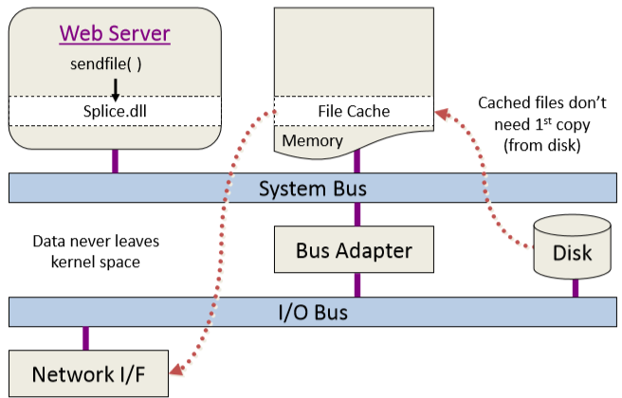
I/O Splicing: read( )/ write( ) sendfile( )

Slide 34
Question？

